Slide 1

Program: Cloud Computing for Big Data Course: Programming Java
Team project: Library Management System
Team name: fantastic four

Slide 2
TEAM MEMBERS
Submitted By
Amandeep Kaur Brar Balpreet Kaur Shilpi Vippandeep Kaur

Slide 3
PROJECT INTRODUCTION
Library Management System
It is desktop based application which is implemented on java platform.
It is very useful for the Librarians to manage the data of all members of the library.
Along with that is also manages the record of books available in the library.

Slide 4
Objectives of the Project are as Follows:
It issues the book offline.
Adds new books.
Shows the list of all the available books.
Adds the new members.
Shows the list of all the members.
Member can Borrow and return the book as well.

Slide 5
Purpose
The purpose of this project is to provide a friendly environment to maintain the details of books and library members.
The main purpose of this project is to maintain easy circulation system using computers and to provide different reports.
Improved customer service through greater access to accurate information
Greater accountability and transparency in operations.

Slide 6
Hardware and Software Requirements
Processor intel core i3
Operating System Windows 10
Memory 4GB or more.
System Type: 64-bit
Eclipse IDE for Java Developer 2019

Slide 7
System Development Life Cycle
Waterfall SDLC Model
Waterfall approach was the first SDLC model to be widely used in software engineering to ensure project success. The entire software development process is divided into separate phases in the "Waterfall" approach. Typically, in this Waterfall method, the result of one step functions sequentially as the reference for the next phase.

Slide 8

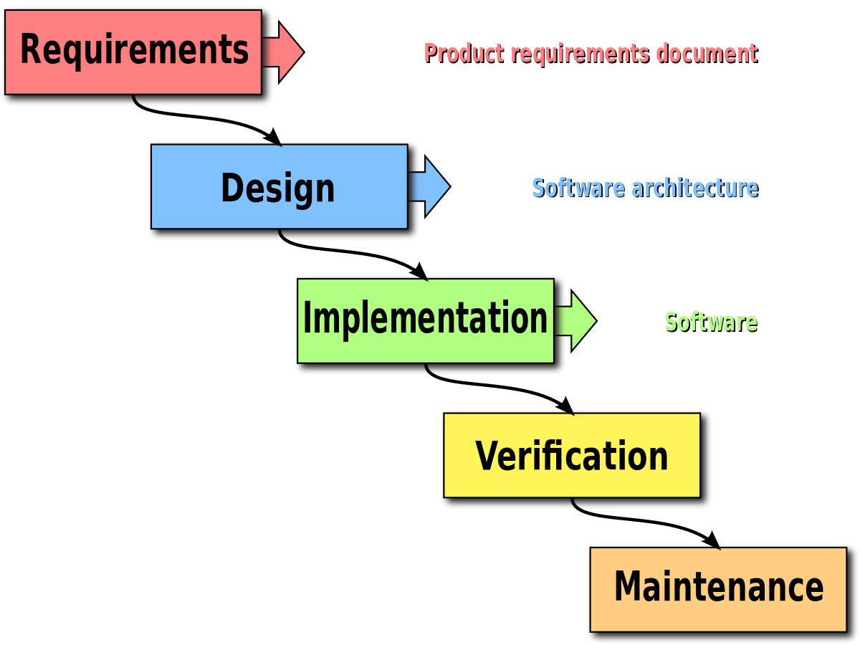
Sequential phases in waterfall model are

Slide 9

Menu bar includes: File Books Members Search loan: to borrow and return books help

Slide 10
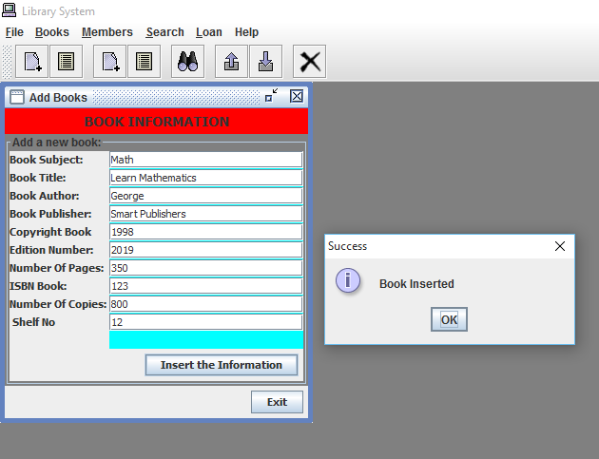
Add Books

Slide 11
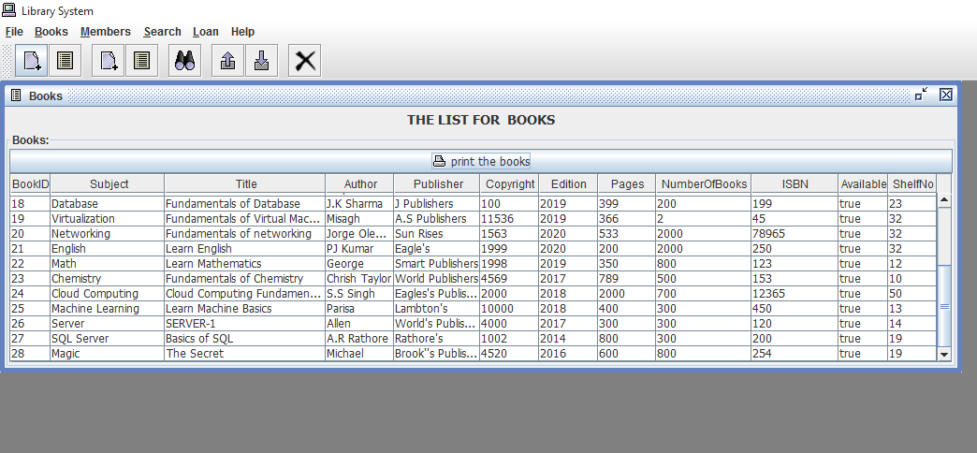
Show the list of books

Slide 12
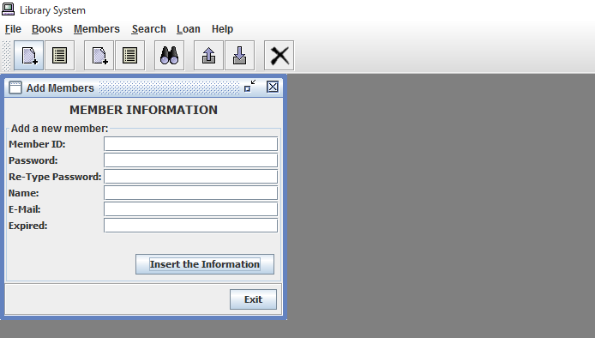
Add a new member

Slide 13
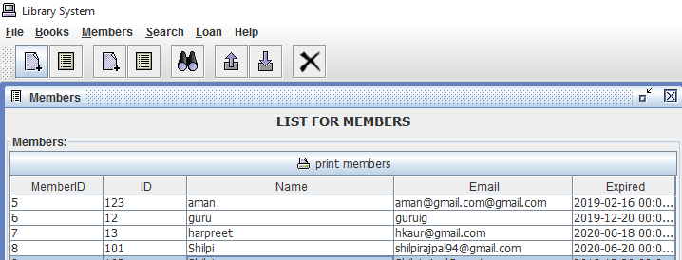
Show the List of members

Slide 14
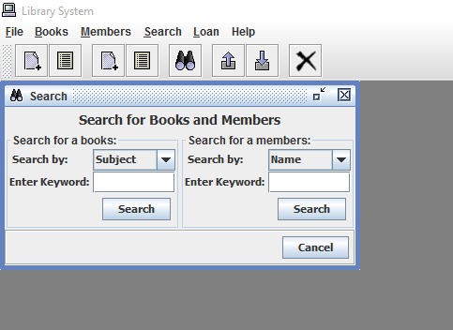
Search for books and members

Slide 15
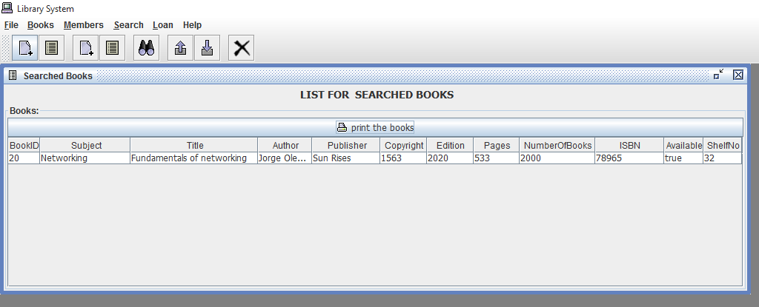
List of searched books

Slide 16
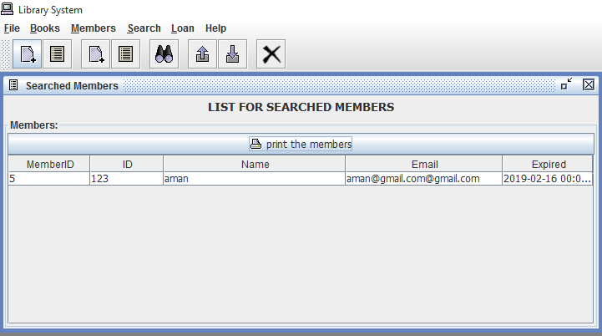
List of searched members

Slide 17
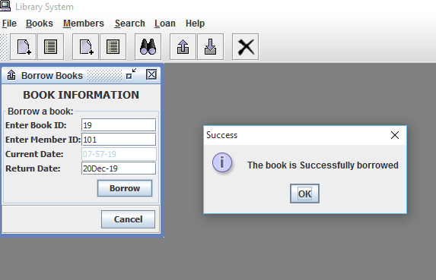
Borrow books

Slide 18
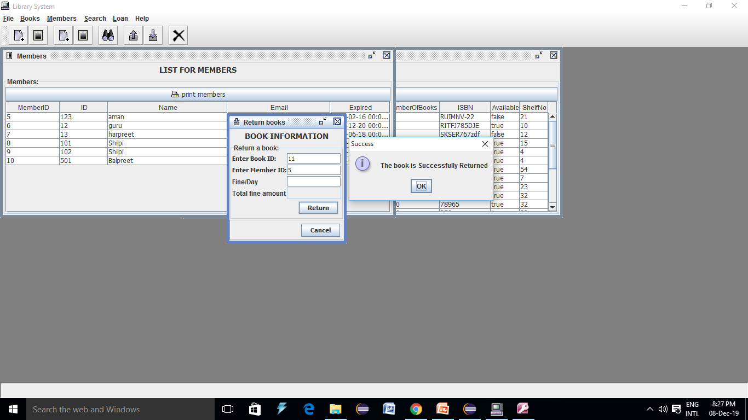
Return Book

Slide 19
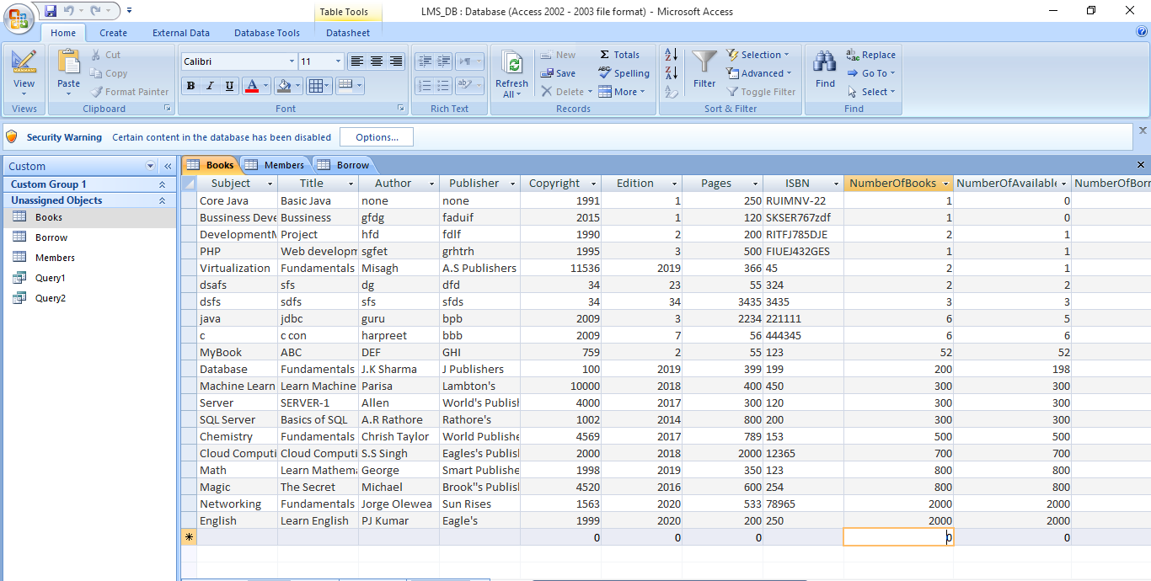
MS Access Database Used Ucanaccess.jar files to connect to MS Access database

Slide 20
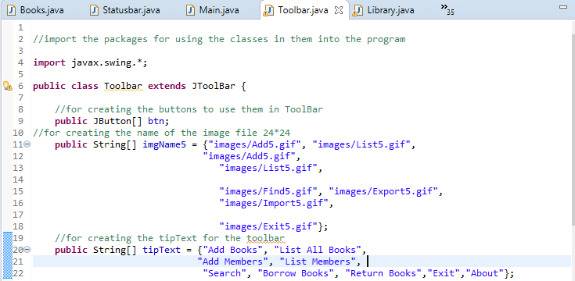
Toolbar- GUI Implementation code

Slide 21
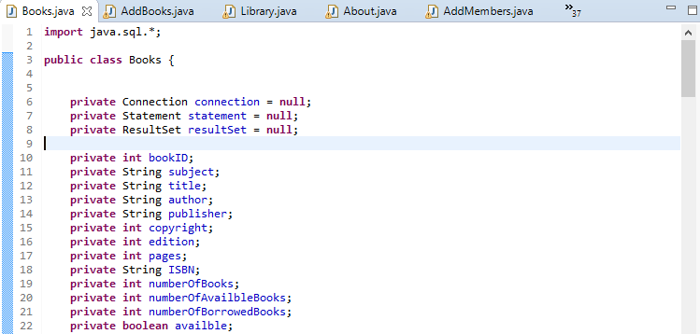
Database Connectivity

Slide 22
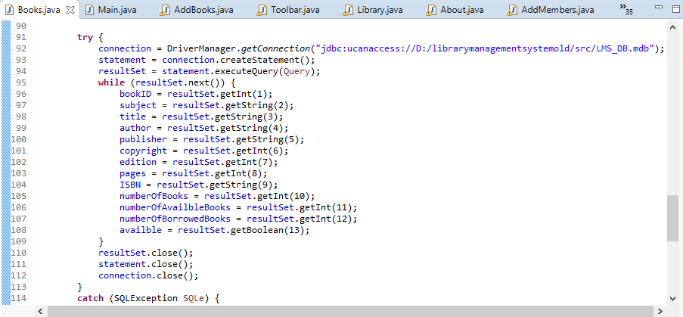
Database Connectivity

Slide 23
Thank You.

